Slide 1

Dell’s
Digital Supply Chain
Aakash Jaiswal Devansh Srivastava Tanisha Malhotra Tanuj Sahal
PHI-PHENOMENA TEAM

Slide 2
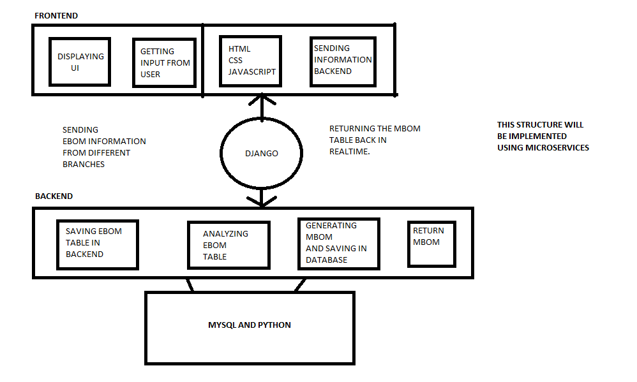
APPLICATION ARCHITECTURE

Slide 3
How we understood the problem
What is Engineering Bill Of Material ?
It is a bill (or say list) of materials that are required to construct the product specified.
Ex. Just like the ingredients are needed to make a dish, in the same way EBOM is the list of ingredients required to build a product.
What is MBOM ?
It is a bill(or say list) of materials that are required to build a shippable product.
Ex. When the dish is ready, it is served on a plate with spoon, fork, knife etc. The same way MBOM is the list materials with which the EBOM will be served as a complete shippable product.
WHAT’S the problem then ?
Notes:
EBOMs
The engineering bill of materials (EBOM) is a special type of bill of material which defines the product as designed. It contains the list of items, parts, components, sub-assemblies and assemblies in the product designed by engineering.
The engineering BOM is often organized by engineers based on the Computer-Aided Design (CAD) or Electronic Design Automation (EDA) tools used. And for any given product design more than one EBOM may be created. For example, the BOM for the Printed Circuit Board Assembly (PCBA) designed by an electric engineer lists the resistors, capacitors and chips. The BOM for the product as designed by a mechanical engineer includes custom parts and purchased hardware like an lcd, buttons and screws.
While multiple engineering BOMs may exist, the EBOM is not the only type of bill of material. The engineering bill of materials (EBOM) deals with how a product is designed, while the manufacturing BOM or MBOM details what is needed to assemble a product and differs from the EBOM in both structure and depth.
How an engineering BOM helps
Manufacturing a product is often compared to that of a recipe. If you miss an ingredient or step in the baking process the outcome will likely be a complete failure. With an engineering BOM, missing a part or component will negatively impact manufacturing the product without any hiccups. Because the information captured in an EBOM is handed-off to manufacturing, the completeness - or lack thereof - could influence the product quality.
MBOMs
The bill of materials is the core of any hardware product. Having an accurate, clean manufacturing bill of materials (MBOM) is important because it provides details on all the parts required to build a shippable product. Unlike the engineering bill of materials (EBOM) which is organized according to the design of a product, the manufacturing BOM is structured to support how a product is assembled. Without a good MBOM, your product is at risk of being built slowly, incorrectly or not at all.
What is a manufacturing bill of materials (MBOM)?
The manufacturing bill of materials (MBOM) is a set of documents which contains all the parts and assemblies required to build a complete and shippable product. This includes packaging materials like colored boxes, CDs and printed quickstart guides. It also incorporates items that are used in the assembly process, like liquid adhesives or tape. Both off-the-shelf (OTS) components and custom, made-to-specification (MTS) parts belong on a manufacturing bill of materials, as well as non-tangible items like firmware. Any item that can be found in the final boxed product needs to be included at some level of the manufacturing BOM.
Some parts require processing—like pad printing, painting or programming—before they are ready to be assembled into a final product. While only the altered part is assembled into the final product, both the pre-processed base part and the finished part are represented on the manufacturing BOM. The manufacturing team needs to know about all the processing steps in order to make critical decisions about which steps will be performed in-house and which will get outsourced to a separate vendor. The location of the processing may be changed during the life of the product to reduce costs, improve quality or increase flexibility.
The major differences between the manufacturing bill of materials (MBOM) and the engineering bill of materials (EBOM) are in their structure and depth. Manufacturing BOMs must contain all the parts and assemblies. If an item needs to be purchased, processed or inventoried to make the product then it needs to be represented on the MBOM. All these parts are structured into the manufacturing bill of materials based on how the product is assembled. For instance, if a product has ten 6-32 screws, each screw is listed in the manufacturing BOM in the subassembly where it is used. On the other hand, the engineering BOM for this product may only have one line item that lists the 6-32 screw with a quantity of 10. The engineering BOM may not provide any information about how parts relate to each other.

Slide 4
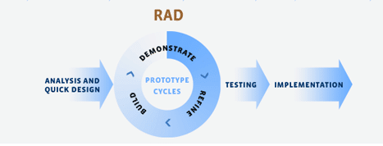
Our Approach
Rapid Application Development model
1. Figure out the requirements
2. Build prototypes, on the double!
3. Get user feedback
4. Do it again!
5. Test, test, test
6. Go present your system!
Notes:
What is rapid application development?
Rapid application development is a form of Agile software development methodology.
In other words, RAD is less talk, more action. Oh, and testing. Lots and lots of testing.
1. Figure out the requirements
2. Build prototypes, on the double!
3. Get user feedback
4. Do it again!
5. Test, test, test
6. Go present your system!

Slide 5
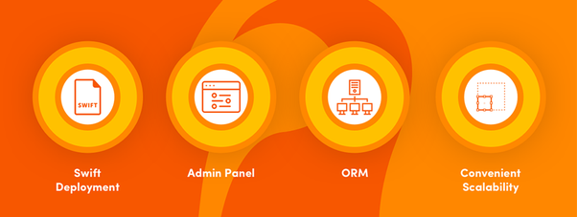
Our Approach
Using Technology stack : Django
Django scalability is also one of the most important part of the project development and evolution.
Notes:
When should you use Django?
Django is built to encourage rapid development and clean, practical design. Like any web application framework, it’s a toolkit of components needed when developing a site. Its purpose is to provide a concrete foundation of the basics, allowing developers to focus on parts of their site that are unique to their project and not waste time with the fundamental boilerplate stuff.
Benefit to the customer:
In case something requires you to change your development team mid-way through your project, Django allows you to find a new team that can comprehend the project’s architecture with very little effort. This can save you a lot of time and money.
Benefit to the developer:
Even if the project is developed by one team from start to finish, using Django makes the development process remarkably quickly, from idea to release through to launch and production. With transparent, clean code, development can be both efficient and effective. And we all know that time = money.
This is why Django is considered “the web framework for perfectionists with deadlines.” It allows any developer to quickly grasp the project’s structure and gives them the tools they need to implement any idea and develop it properly, and in record time.
Microservice Architecture is a method of deploying software systems that try to focus on building single-function modules with well-defined interfaces and operations. Netflix, eBay, Amazon, Twitter, PayPal, and other tech stars have all evolved from monolithic to microservices architecture.Microservices solve these challenges of monolithic systems by being as modular as possible.

Slide 6
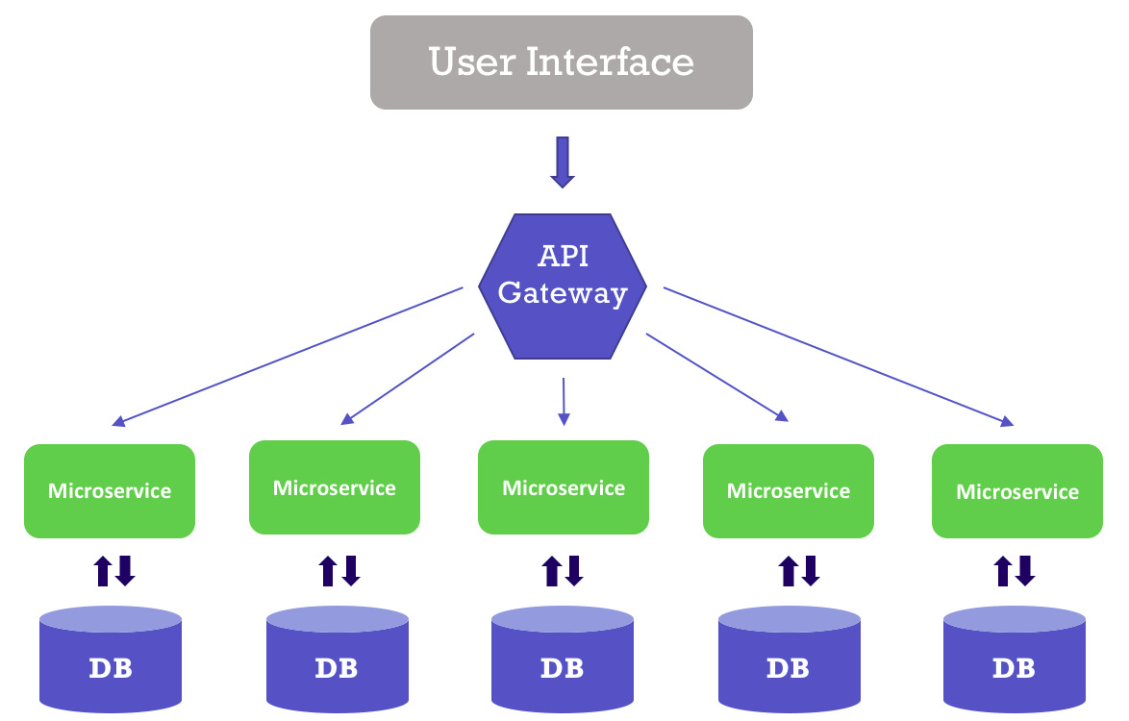
Our Approach
Converting EBOM to MBOM in efficient way possible using microservices.
Notes:
Microservice Architecture is a method of deploying software systems that try to focus on building single-function modules with well-defined interfaces and operations. Netflix, eBay, Amazon, Twitter, PayPal, and other tech stars have all evolved from monolithic to microservices architecture.Microservices solve these challenges of monolithic systems by being as modular as possible.

Slide 7
Milestones Achieved
Basic UI is ready with database panel.
Making EBOM and converting into MBOM through database linkages.
Microservices deployed in fetching of data.

Slide 8
More to Come….
Our project technology is scalable, portable, adaptable and hostable on Amazon, Heroku, Digitalocean, and more due to Django technology stack.

